Slide 1
Project Topics Presentation
STES’S SINHGAD ACADEMY OF ENGINEERING
KONDHWA, PUNE 411048
By : Project Group 48
COB B018 - Komal Pradip Naphade
COB B046 - Pranav Nandkishor Gavali
COB B071 - Dhiraj Kailas Shelke

Slide 2
IoT Based Hydroponics System
Hydroponics is a technique of growing plants without soil and without the limitations of space and climate. In the traditional farming system, plants depend on soil to obtain all nutrients needed for their growth. In contrast, a hydroponic garden provides all of these nutrients without involving sunlight, soil, extra labour.
Objectives
To cultivate vegetables with minimal use of soil and water.
To supply the ideal nutritional environment for optimum plant performance.
To allow farmers to benefit from efficiencies and to reap large produce yields.

Slide 3
Problem definition
To implement a Hydroponics System with Help of IoT to grow plants without soil and without the limitations of space and climate and to supply the ideal nutritional environment for optimum plant performance.
Requirements
Power Supply Break Switch
Water Pump
Horticulture Lighting( Grow Lights) with Regulator
Pipes to transfer fluids
A Controller to control the System (Arduino)

Slide 4
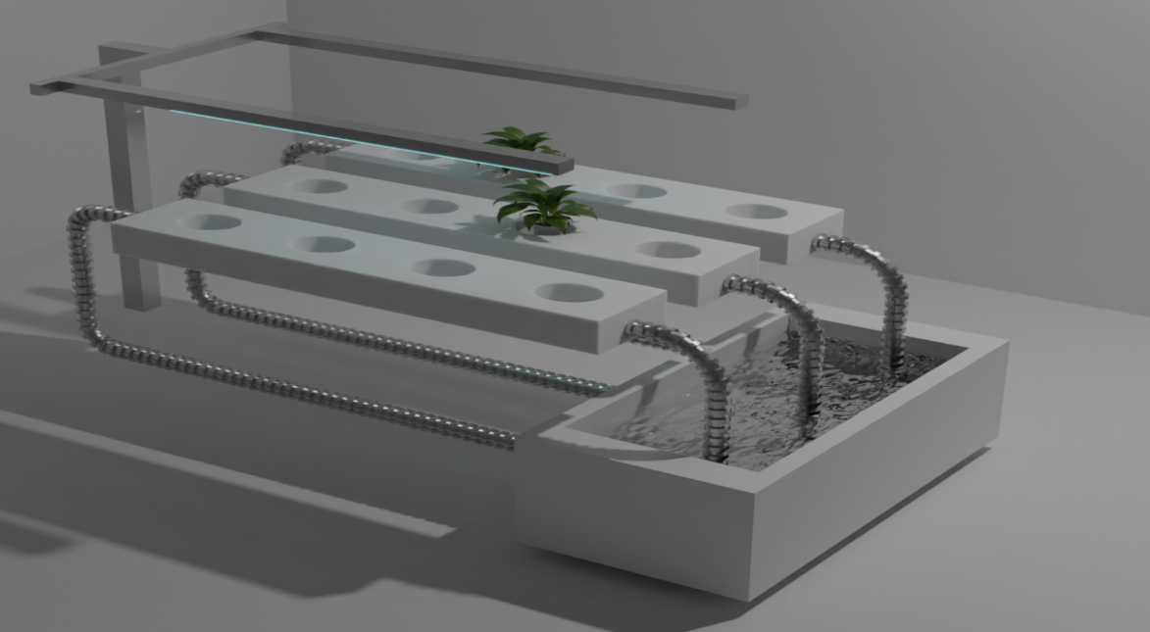
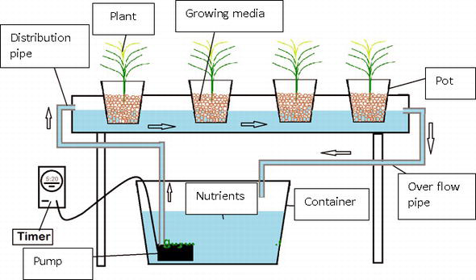
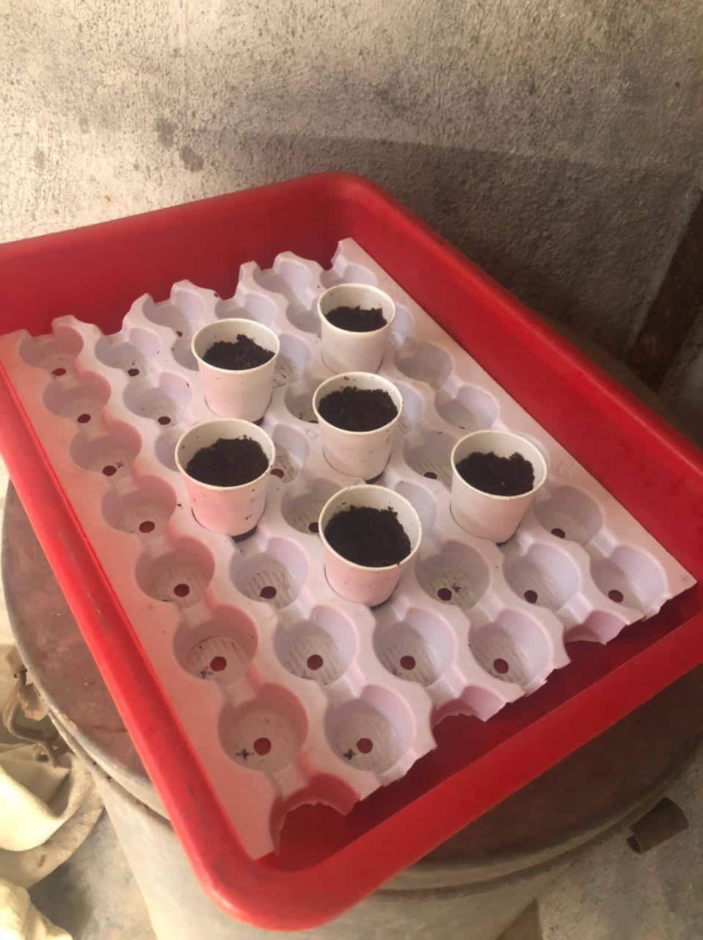
Work Model

Slide 5
Health Assistance using CNN
Intelligent health assistant is a CNN based personal assistant basically a service, which is powered by AI rules, and one can interact with it via a chat interface.
When the system receives the descriptions of user’s symptom, it conducts both web search and local medical knowledge database search.
CNN is an algorithm which can take in an input image, assign importance to various aspects/objects in the image and be able to differentiate one from the other
Objectives
To predict disease from symptoms and health history using CNN.
To predict the chronic diseases without visiting physician or doctor for diagnosis.
To counsel the best expert advises on many different types of diseases.
To reduce the complexity of healthcare services.
To improve the lives of people who have busy schedule to easily keep a check on their health. .

Slide 6
Problem definition
To implement an intelligent health assistant using CNN for various disease detection and risk prediction without visiting physician or doctor for diagnosis using different techniques of machine learning.
Requirements
User Module to Enter Symptoms
Database to store files and store different disease data
Pycharm Integrated Development Environment(IDE)

Slide 7
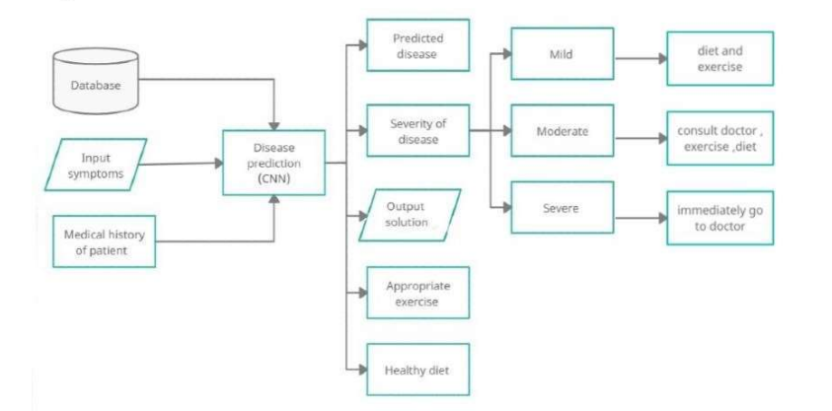
FlowCHART

Slide 8
Stock Trend Prediction
Stock Trend prediction is a prediction system that illuminate the risk that undergoes during the investment in stock market. Forecasting of the stock trend prediction is done by the available data source and prediction is done for Up trend and down trend.
Objectives
To identify factors affecting share market.
To generate a pattern from large dataset of stock market for predictions.

Slide 9
Problem Statement
To implement a Stock trend Prediction System to help financial investors to take right decisions while investing in Share Market.
Requirements
User Module to Enter Stock Ticker
Stock Dataset to analyze values and provide predictions
Integrated Development Environment(IDE)
Jupyter Notebook

Slide 10
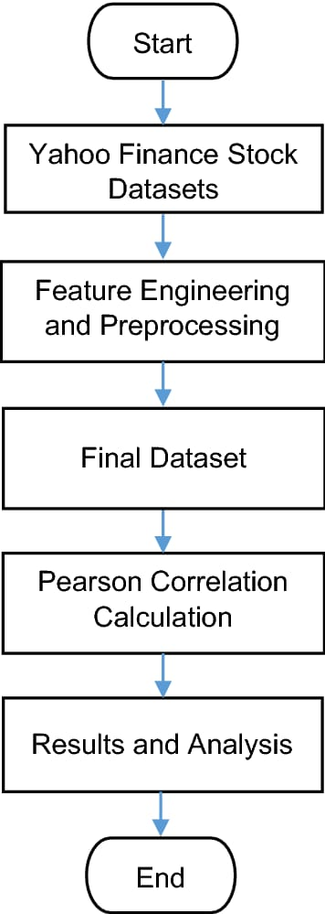
FlowCHART

Slide 11
Handwritten Digit Classification
In this project, we will focus on building a mechanism that will recognize handwritten digits. We will be reading images containing handwritten digits extracted from the MNIST database and try to recognize which digit is represented by that image.
Objectives
To apply image correlation techniques.
To ensure effective and reliable approaches for recognition of handwritten digits.
To use Machine Learning for training the program.

Slide 12
Problem Statement
To create a model that will be able to recognize and determine the handwritten digits from its image by using the concepts of Machine learning
Requirements
MNIST Dataset to analyze values and provide predictions
Integrated Development Environment(IDE)
Jupyter Notebook

Slide 13
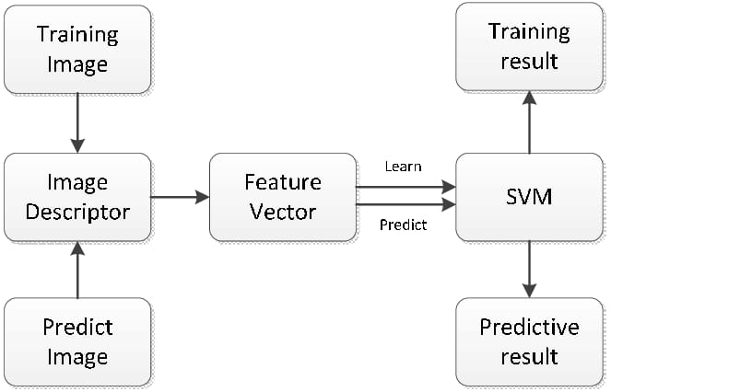
FlowCHART

Slide 14
Vision : AI Desktop voice assistant for Visually impaired
The project aims to develop a personal-assistant. This assistant draws its inspiration from virtual assistants like cortana for windows, and siri for ios. It has been designed to provide a user-friendly interface for carrying out a variety of tasks by employing certain well-defined commands. Users can interact with the assistant either through voice commands or using keyboard input.
Objectives
To provide the Users with a Virtual Assistant that would not only aid in their daily routine tasks like searching the web, extracting weather data, vocabulary help and many others but also help in automation of various activities.
To use Machine Learning for training the program.

Slide 15
Problem Statement
To implement an AI desktop Voice Assistant that will be able to perform certain automated tasks by using the concepts of Machine learning and Artificial Intelligence.
Requirements
Microsoft developed speech APIs
Google Voice APIs
Integrated Development Environment(IDE)
Code Editor – VS Code

Slide 16
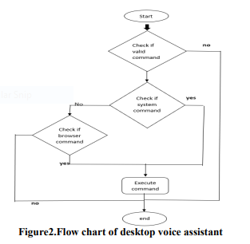
Flowchart

Slide 17
THANK YOU

